Slide 1
Architecture and the 3D Cube
Kim Horn
Version 1.61
1/2/2024

Slide 2
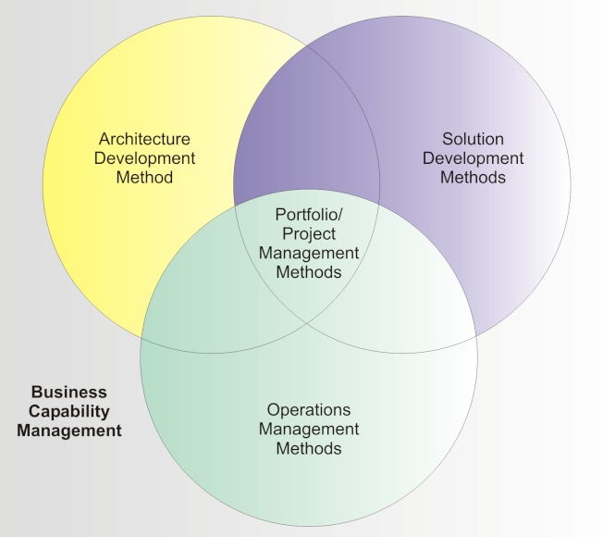
Agenda
Stakeholders and Views
Prior Approaches
The 3D Cube:
Service Tiers
Layers
Qualities
Stakeholder Views
System Architecture Document
Value of the Cube
This is a short introduction, all aspects are detailed in further packs.

Slide 3
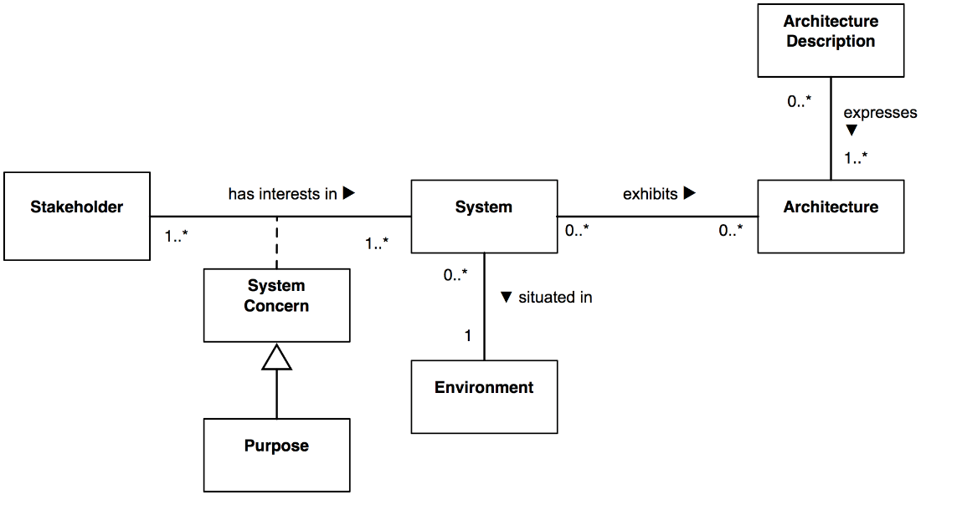
Stakeholders
A stakeholder is any person or group who have some vested interest or concerns about the system.
Each Stakeholders has a different need or concern and views the system in a different way; they have points of view.
A deployed system ‘exhibits’ an architecture ‘expressed’ by a ‘description’.
Customer
Owners
Maintainers
Users
The System
Developers
Suppliers
Operators
Builders
Acquirers
Architects

Slide 4
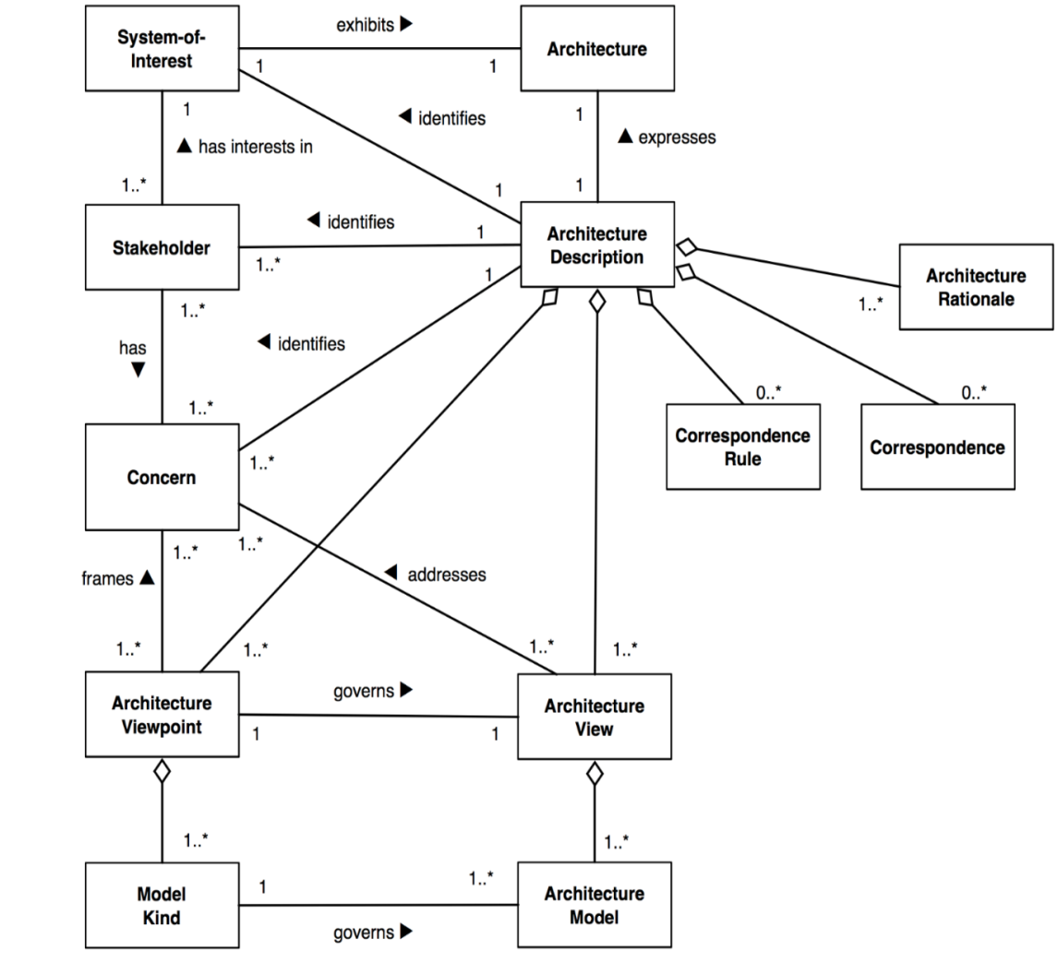
Architecture Description ISO Standard
System | Collection of components (business and technical) organized to accomplish a specific function or set of functions
Architecture | The system’s fundamental organization, embodied in its components, their relationships to each other and to the environment, and the principles guiding its design and evolution
Architecture Description | Collection of artifacts that document an architecture – to meet the concerns of stakeholders
Stakeholder | Person (or group of people) who has a key role in, or concern about, the system
Concern | Key interests that are crucially important to the stakeholders in the system and determine the acceptability of the system
View | Representation of a whole system from the perspective of a related set of concerns
Viewpoint | Defines the perspective from which a view is taken: How to construct and use a view Information that should appear in the view Modeling techniques for expressing and analysing the information Rationale for these choice
Ref: ISO/IEC/IEEE 42010 Systems and software engineering — Architecture description

Slide 5
What is Architecture?
Architecture is a set of structuring principles that enables a system to be comprised of a set of simpler systems, each with its own local context that is independent of but not inconsistent with the context of the larger system as a whole. Sun
“...the structure or structures of the system, which comprise software components, the externally visible properties of those components, and the relationships among them. By “externally visible” properties, we are referring to those assumptions other components can make of a component, such as its provided services, performance characteristics, fault handling, shared resource usage, and so on ”
Bass, Clements, Kaxman, Software Architecture in Practice

Slide 6
More Definitions
The structure of the components of a program/system, their interrelationships, and principles and guidelines governing their design and evolution over time .
Garlan and Perry, 1995
...beyond the algorithms and data structures of the computation; designing and specifying the overall system structure emerges as a new kind of problem. Structural issues include gross organization and global control structure; protocols for communication, synchronization, and data access; assignment of functionality to design elements; physical distribution; composition of design elements; scaling and performance; and selection among design alternatives .
Garlan and Shaw, 1993
A set of... design elements that have a particular form .
Perry and Wolf, 1992

Slide 7
Architecture has 3 main Common Themes
Done for a Purpose
Structure and Organization
Done to the Degree Required
Notes:
Difficult to find a good or to agree on an architecture definition. All definitions have the following themes.
Arch is structure and org of a system. when architecting think about why you are doing it and how far to go (knowing when to stop)
See SEI web site for this collection of definitions.

Slide 8
Done for a Purpose – The Purpose of Architecture:
Provide an holistic view of a solution.
Produce views of the system for particular stakeholders.
Ensure requirements can be satisfied (especially Systemic Qualities, NFR's and ASUC’s).
Mitigate risk and reduce uncertainty.
Manage complexity.
Explain why the form of a system has come to be.
Make project management possible:
Decomposition allows Work Breakdown Structures to be managed.
Enables team structures to be defined.
Satisfy budget and schedule.
Justify purchasing decisions.
Makes designers/implementers productive.
Re-use existing assets.
Notes:
Architecture is done for a purpose

Slide 9
Structure and Organisation
Define the Context, the between the system and its environment
Decomposition
Subsystems / Components / Configurations
Boundaries / Interfaces
Relationships
Overlapping concerns
Needed Mechanisms
Instantiation / Selection:
Mechanisms, tools, libraries …..
Frameworks, Patterns ….
Balance buy vs. build
Examples
Providing examples e.g. motifs, patterns, etc.
Leveraging examples e.g. reference architectures, comparable solutions, etc.
Notes:
Decomposition Note:
specifying interfaces is often more of a design activity than architecture. The architect may be concerned with defining the nature of interfaces or the protocols and standards used with interfaces.
Example notes:
Provide examples for designer and developers and remaining audience to enable them to do their job
Reference architectures: look at reference architectures formulated around the same concepts. E.g. if you are building an e-commerce site, it’s quite similar to what an e-commerce site looks like

Slide 10
Done to the Degree Required to:
Mitigate Risks.
Solve the “hard” problems; the ASUCs.
Ensure the requirements, especially the NFRs are satisfiable:
Security
Scalability
Availability
….
Structure teams and allow them to operate in relative independence.
Define their goals and objectives, at the right levels
Remove team dependencies.
Notes:
Architecture is done to he degree required to:
Confidence that you can meet SLR’s not that you have met them already
How far do you take architecture:
Project has many senior developers so can safely stop architecture at design and let the developers take-over.
Project has no senior developers, and so the architect will mentor developers through design.
So some times you take it further than others.

Slide 11
Architect’s Concern
Making a complex thing “buildable”
Specify a reasoned decomposition, instantiation, and structural foundation;
Make sub teams of designers and implementers productive;
Enable sub teams to operate in relative isolation;
Facilitate planning and tracking around these teams.
Derive technical requirements from business requirements
Such that:
Requirements are met and tracked
Derived technical requirements are clear
Systemic qualities are achieved

Slide 12
Architecture Vs Design
Design is Concerned with | Architecture is concerned with
Depth | Breadth and some depth
The code | What is important besides the code
Problem solving by accounting for details | Problem solving by applying solutions that encapsulate detail
Up-to-date general knowledge and maybe specific product knowledge | Up-to-date general and system-level product knowledge
What happens when a button is pushed? | How often the button is pushed, how many users are simultaneously pushing the button, where the users physically are when they push the button
Self or small team | Structure of teams, large solution with multiple teams and keeping them teams together: Maintain arch. Integrity Communicate & lead
Notes:
Change your thought process from designer to architect
If your experience is only design, it doesn’t scale well and you need to get architecture experience

Slide 13
Views and Viewpoints (background)

Slide 14
Have been many different View / ViewPoint Models
8 of them are:
RUP 4+1 Views – Philip Kruchten, 1995 (IEEE Software);
Siemens Four – Soni, Nord & Hofmeister, 1995;
Business Component Factory – Herzum & Sims 1999;
SEI View Model – Clements et al, 2002;
Garland & Anthony 2003;
ISO RM-ODP - ISO/IEC 10746;
Microsoft DDD
Rozanski & Woods – 7 Viewpoints 2012;

Slide 15
RUP 4+1 Views – Philip Kruchten, 1995 (IEEE Software)
An ‘ancient’ model from last century.
Variety of naming schemes and many interpretations……
Issues:
What are viewpoints ?
Where are the services, platforms, infrastructure, etc ?
Where are the NFRs, that drive Architecture; not the Functional Use Cases !!!!
Someone added a Data View ?
Out of date for SOA, Cloud…
So generic it provides little value
Where are the tiers/layers ?
etc…..
Logical / Design View
Implementation / Development View
Use Case View
Process View
Physical / Deployment View
Data View
A detailed document on issues with 4+1, comparing the Cube, is available on request.

Slide 16
Six Common Layering Models
DDD – Eric Evans
Enterprise Java - Brown
Core J2EE – origin of Cube from Sun
Microsoft DNA
Microsoft DDD – updated DNA, based on Domain Driven Patterns
EJB Design - Marinescu
Fowler
.Net Enterprise Design - Nilson
User Interface
Application
Domain
Infrastructure

Slide 17
Web Architecture - Back in 2001
“The Architecture of Web Applications”, Grady Booch, 1 Jun 2001
Web Server
Application Server
Data
Page Request
Web Browser
File
System
External Systems
Issue: This is a single very specific, simplistic and high level view.

Slide 18
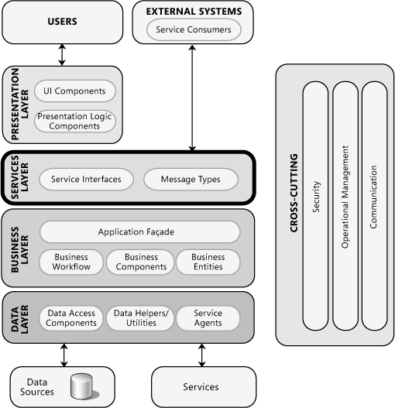
MicroSoft Application Architecture (Early)
Add:
Layers
Service Layer - B2B by-passing presentation
Components
Patterns
Cross-cutting concerns

Slide 19
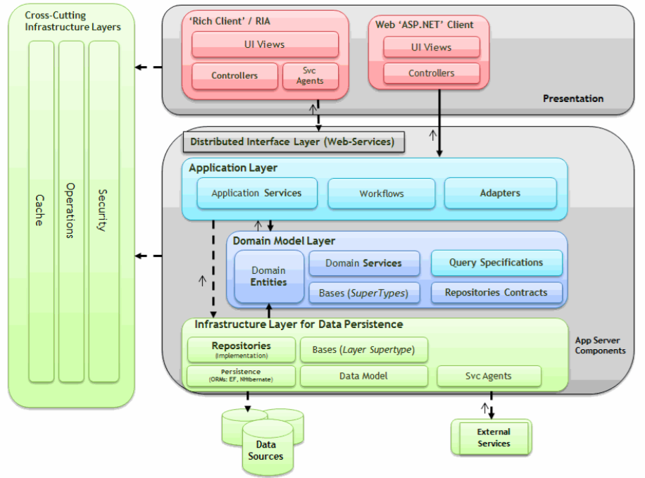
Microsoft DDD N-Layer Architecture Style (Recent)

Slide 20
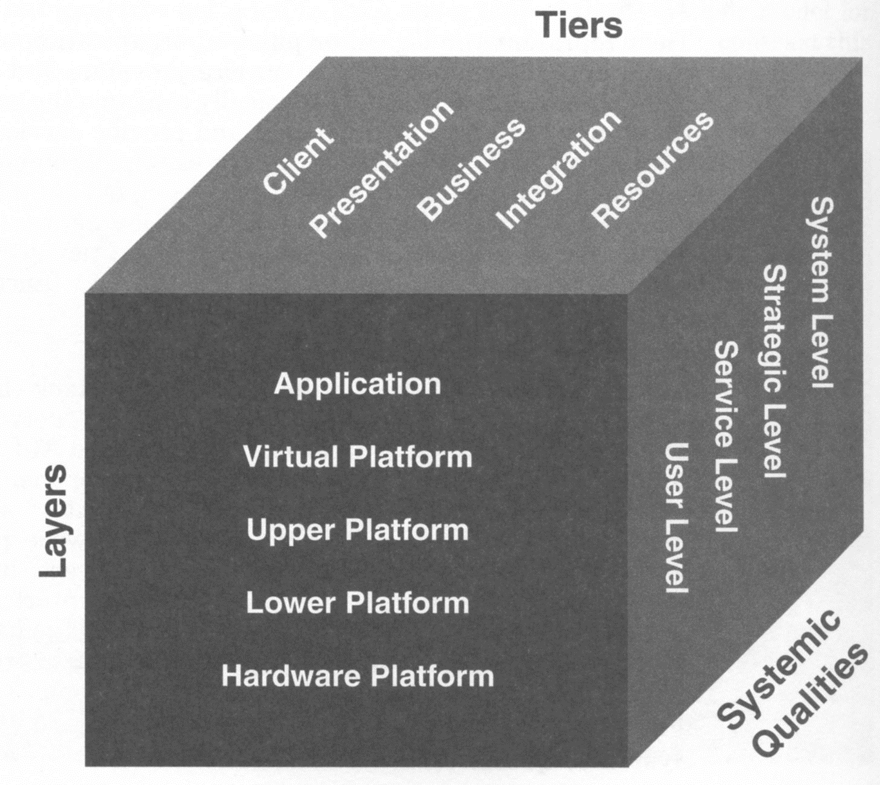
The 3D Cube
Services
A 3-D Conceptual Partitioning of an N-Tier or Service Based Composite System (Application).
Provides a well defined context for views and viewpoints.
Originally published in 2001 by Sun.
Things have changed, and improved:
Client
Presentation
Domain
Access
Application
Integration
Resource
Cloud, Containers, DevOps;
Evolutionary Architecture;
Microservices, API, Lambda;
Polyglot(Java, .Net, Ruby…)
Evolutionary
Software
Developmental
Software Platform
Manifest
Infrastructure Layers
Shared Services
Operational
Operating Platform
Compute and Network
Capabilities / Qualities
Facilities
Old (2000)
New (2017)

Slide 21
What is an Application ?
“A deployed and operational IT system that supports business functions and services; for example, a payroll. Applications use data and are supported by multiple technology components but are distinct from the technology components that support the application.”
TOGAF
“A deployable collection of software components which uses computing technology to perform automated processes that support one or more business functions and which may utilises persistent or temporary data stores.”
Kim
A Software Application is essentially a social construct, and the boundaries between application can be hard to determine. It could be defined by the team building and operating it, funding, a set of business capabilities, a set of initiates delivering an objective, acquisitions and by bounded context.

Slide 22
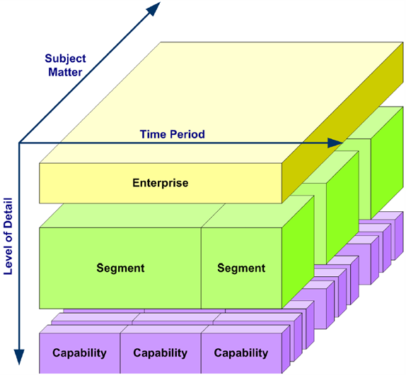
The Cube and an Enterprise Architecture
Business
A cube provides a capability; a thin slice across each of the 4 enterprise architecture domains
Information
Application
Technical
Application
Client
Presentation
Domain
Access
Integration
Resource
Evolutionary
Software
Developmental
Software Platform
Manifest
Shared Services
Operational
Operating Platform
Compute and Network
Facilities

Slide 23
The Service Tiers

Slide 24
The Services
A Service is a component boundary that exists to provide isolation. The components provides a distributed or specific role, responsibility or capability, supporting a business process.
The services are tiered:
applies the layering decomposition pattern to system structure. The layers (tiers) are logical slices that carry out specific system responsibilities.
may not reside on the same physical box;
may not be provided by the same technology and infrastructure;
may be in different locations, distributed and reside on different devices;
are a primary technique for building scalable systems that support continuous delivery and dev ops;
Services
Client
Presentation
Domain
Access
Application
Integration
Resource
Evolutionary
Software
Developmental
Software Platform
Manifest
Layers
Shared Services
Operational
Operating Platform
Compute and Network
Capabilities / Qualities
Facilities

Slide 25
Channels Reach Into Services via Channels
Clients (users) via various channels, access the organisation’s services.
Services
Web/Portals
Mobile
Client
Presentation
Domain
Access
Application
Integration
Resource
B2B
Services/APIs
Evolutionary
Channels
Software
Developmental
Software Platform
Manifest
Layers
Shared Services
Operational
Operating Platform
Compute and Network
Capabilities / Qualities
Facilities

Slide 26
Service Layering
OASIS defines service as:
“A mechanism to enable access to one or more capabilities, where the access is provided using a prescribed interface and is exercised consistent with constraints and policies as specified by the service description.”
Services
Orchestration (Business Process)
Stateless Services
Stateful Services
Service Compositions (Tasks)
Infrastructure (Utility) Services
Business (Entities/Tasks) Services
Domain (Entities/Tasks) Services

Slide 27
Application ‘Layer’ Services Vs Domain ‘Layer’ Services
Distributed Services
APIs, REST
Web Services
Micro/Macro(SOA) services
Client
Presentation
Domain
Access
Application
Integration
Resource
Application Services
Application Tasks (stateless)
Application Workflow
Adapters
Application Services coordinate the technical plumbing (like using a Unit of Work and Transactions) so that the Domain Layer is as clean as possible and expresses its ‘entity’ logic clearly.
Evolutionary
Software
Developmental
Software Platform
Manifest
Shared Services
Operational
Domain Services
e.g. TransferFunds
Operating Platform
DDD Domain Objects
Service
Entities
Aggregate
Specification
Value Object
Compute and Network
Facilities
Domain Events
Notes:
The term service is overloaded in software development. The definition here is not directly related to microservices.
Domain events. Domain events can be used to notify other parts of the system when something happens. As the name suggests, domain events should mean something within the domain. For example, "a record was inserted into a table" is not a domain event. "A delivery was cancelled" is a domain event.
Domain events are especially relevant in a microservices architecture. Because microservices are distributed and don't share data stores, domain events provide a way for microservices to coordinate with each other. The article Interservice communication discusses asynchronous messaging in more detail.

Slide 28
DDD Example – Transfer Funds From Savings to Cheque Accounts
Cube Tiers
Application Service:
Receives Input from UI
Tells Domain to Transfer
Wait for confirmation
Send Email Notification
Domain Service:
Connects to Domain Objects: Savings, Cheque, and Ledger.
Orchestrates Debit and Credit
Returns Confirmation
Infrastructure Service:
Writes Account and Ledger State to DB – OR mapper
Send Emails
DDD Layers
Client
User Interface
Presentation
Application
Application
Domain
Domain
Infrastructure
Integration
Resource

Slide 29
Physical Vs Logical Tiering – Runtime Structure Decision
Outside
Inside Enterprise
* Modelled by Layer Views
Server could be a container
2 Tier: Client Server
Client
Presentation
Application
Domain
Integration
Resource
Application *
3 Tier
Client
Presentation
Application
Domain
Integration
Resource
Web/Application Server *
DB Server
4 Tier
Client
Presentation
Application
Domain
Integration
Resource
Web Server
Application/Worker Server
DB Server
Firewall (Access Tier)
Application Boundary

Slide 30
Physical Tiering – Example: Web Rich Client / API Model
Outside
Inside Enterprise
Browser Presentation
JSON / HTTP
API
Client
Presentation
Application
Domain
Integration
Resource
Application/Worker Server
DB Server
Browser + Rich
Asynchronous Client
HTML / HTTP
Presentation
Domain
Integration
Client
Resource
Web Server
Presentation
JSON / HTTP
API
DB Server
Domain
Application
Domain
Integration
Integration
Application/Worker Server
Firewall (Access Tier)

Slide 31
Gateway Example: Mobile Device via API to Business
Example of API Gateway Pattern
SSO Provider
Client
Access
Application
Domain
Integration
Resource
Mobile Device
API Gateway /
BEFE / Edge *
Application Server
DB Server
Presentation
Domain
Integration
Resource
Mobile App
Lightweight Mobile DB
Access
* Access via API Gateway/Edge can provide SSO, Auth point. It may integrate to an external identity provider, e.g. Auth0, Okta.
API Gateway / BEFE

Slide 32
Service Re-use Example: SOA / Microservices Model
Ordering Portal Application calls the two Services independently and composes the results
Ordering Portal Application
Client
Presentation
Application
Domain
Integration
Resource
Web Server
Application Server
DB Server
Customer Micro-Service
SOAP/MQ, JSON/HTML,
SOAP/HTML
Application
Domain
Integration
Resource
Application/Worker Server
Customer DB Server
Order Micro-Service
Application
Domain
Integration
Resource
Application/Worker Server
Order DB Server

Slide 33
Service Orchestration Example
Ordering Portal Application calls the Customer Order MS that Services composes (orchestrates) the results
Ordering Portal Application
Client
Presentation
Application
Domain
Integration
Resource
Customer Micro-Service
Customer Order Micro-Service
Application
Domain
Integration
Resource
Application
Domain
Integration
Order Micro-Service
Application
Domain
Integration
Resource

Slide 34
Example: Ordering Portal Tiers and Deployment
Access
Tier
4 Tiers deployed in Monolith Jetty application
Browser
HTML / HTTP
Jetty
Client
Presentation
Presentation
Application
Domain
Integration
Resource
JSON / HTTP
Portal DB Server
iB2B Services
Email
Examples: Global Site Selector, WAF, Load Balancers, Apache Proxy, WebGate, API Gateway, BEFE

Slide 35
Microservices / Self Contained System - Slice the Tiers
Decompose, slice, the domain into independent Services.
Services
MS-1
May separate a Monolith into separate Bounded Contexts each provided by an independent system/service;
Two approaches:
‘Self Contained System’ (SCS) is a vertical slice of a Monolith that is autonomous, it has its own UI, business logic and data storage.
‘Microservices’ also cut across the Tiers for a specific part of the business domain; however unlike and SCS they share tiers/services;
‘API Gateway’ provides Access via boundary external/internal or domain/subdomain;
Microservices may provide their own Presentation, e.g. Protobuf/ JSON/HTML/XML…..
Domain services may be Orchestrated by the Services Layer
MS-2
Application
Client
Presentation
Domain
MS-3
Access
Integration
Resource
MS-4
MS-5
Evolutionary
Software
Developmental
Software Platform
Manifest
Layers
Shared Services
Operational
Operating Platform
Compute and Network
Capabilities / Qualities
Facilities

Slide 36
MicroFront Ends / Self Contained System - Slice the Tiers
Tiers / Services
Micro Front Ends (MFs) may separate a Front End Monolith into separate Bounded Contexts as with backend)
The idea behind MFs is to think about a website or web app as a composition of features which are owned by independent teams.
Each team has a distinct area of business or mission it cares about and specialises in.
A team is cross functional and develops its features end-to-end, from database to user interface.
MF-1
MF-2
Application
MF-3
Client
Presentation
Domain
Access
Integration
Resource
MF-4
MF-5
Evolutionary
Software
Developmental
Software Platform
Manifest
Layers
Shared Services
Operational
Operating Platform
Compute and Network
Capabilities / Qualities
Facilities

Slide 37
CAs Layered API Architecture - To Cube / Tiers
Client
Security
Caching
Representation
Orchestration
Implementation
Backend
Application
Client
Presentation
Domain
Access
Integration
Resource
Evolutionary
Software
Developmental
Software Platform
Manifest
Shared Services
Operational
Operating Platform
Compute and Network
Facilities
Notes:
Presentation Tier provides different Representation for the API.
Also provides and ACL Layer

Slide 38
Infrastructure Layers

Slide 39
The Layers - Infrastructure
Infrastructure Layers Provide the Hardware and Software Stack at each Service Tier.
Decouples the supporting ‘Infrastructure’, cross cutting concerns and mechanisms from the Tiers and Services, so the former are easier to model and understand.
Provides Context for views.
The ‘Software’ is the code written on top of the Platforms:
Services
Infrastructure Layers Provide the Hardware and Software Stack
Client
Presentation
Domain
Access
Application
Integration
Resource
Evolutionary
Software
The Software Platform provides ‘Standards’ or a framework we build against, that implicitly require infrastructure.
The Operating Platform abstracts away the Boxes and Wires (Compute and Network).
Facilities are deployment locations, environments (e.g., dev, test, staging) and physical access points.
Developmental
Software Platform
Manifest
Infrastructure Layers
Shared Services
Operational
Platforms
Operating Platform
Compute and Network
Capabilities / Qualities
Facilities

Slide 40
Software Platform has implicit Software Infrastructure Layer
The Software Platform offers portability, exposing a software standard, such as J2EE, JEE or SQL, and provides for choice of implementation. Software Infrastructure layer implements it, and is vendor/provider specific. Example Application Servers include: Glassfish, JBOSS, Wildfly, Tomcat, TomcatEE, Geronimo, Jetty, Jonas, Resin etc. There are many SQL Server implementations.
Software Platform.
JEE
JEE
JSP
SQL
SQL
SQL
Software Infrastructure
Weblogic Application Server
Wildfly
Apache
Tomcat
MYSQL
Oracle
AWS RDS
Despite being a distinct layer, it is implicit in the cube, being so tightly coupled with the Software Platform. Often the Infrastructure and Platform are all provided and not standardised, for example NOSQL DBMSs, e.g. MONGO. The Infrastructure can also be provided in the layer below as a shared service like AWS RDS. When there is distinct infrastructure it should be described.

Slide 41
Kafka Example
Application
Presentation
Integration
Client
Domain
Resource
Access
<dependency>
<groupId>org.springframework.cloud</groupId>
<artifactId>spring-cloud-stream</artifactId>
</dependency>
<dependency>
<groupId>org.springframework.cloud</groupId>
<artifactId>spring-cloud-starter-stream-kafka</artifactId>
</dependency>
<dependency>
<groupId>postgresql</groupId>
<artifactId>postgresql</artifactId>
<version>9.1-901.jdbc4</version>
<dependency>
Java Streams
& Repository
Standards
Software
Evolutionary
Software Platform
Developmental
Manifest
Kafka,
DBMS
Shared Services
Operational
Operating Platform
Compute and Network
Facilities
Service, Domain Entity, Repository, Resource
App Service Processes Stream (Java Standard)
Software Platform hides Kafka
@Service
public class OrderService {
@HystrixCommand
public void updateOrderStatus(String orderId, String status)
{
logger.debug("Getting the Order by OrderID");
Order order = orderRepository.findByOrderId(orderId);
order.setStatus(status);
orderRepository.save(order);
logger.debug("updated Order Status");
}
}
@SpringBootApplication
public class Application {
@StreamListener(Sink.INPUT)
public void statusSink(MessageModel messEvent) {
logger.debug("Received an event Type: {} Status: {}", messEvent.getOrderId(), messEvent.getStatus());
orderService.updateOrderStatus(messEvent.getOrderId(),messEvent.getStatus());
}
Notes:
Our application gets a message from the Status Service, via Kafka, and saves it to the DBMS

Slide 42
Example: Product Ordering Web Site
WAF, Webgate/OAM
Loadbalancers
Spring POJO’s
Platforms & Infrastructure
Across Tiers
Web Browser, Email
Javascript, HTML
Spring MVC
HTML,
Servlets
Portal DB, Services via ESB
SQL, XML
Hibernate
JMS
These Logical Spring tiers deployed Physically together
Application
Client
Presentation
Domain
Access
Integration
Code: Java, Ruby, HTML, SQL, XML, Javascript
Deployment RPMs
Resource
Jetty, Spring/Hibernate, HTML, Java 6 , Servlets Freemarker, LDAP, JMS, SQL
Evolutionary
Software
Developmental
Oracle DBMS, IBM MQ
ESB Services, Webgate AD/OAM, Email, ELK, Build Tool Chain
Software Platform
Manifest
Shared Services
Operational
Redhat VM Vmware / Docker
Operating Platform
Unknown
Compute and Network
Corporate, DC1, DC2,
Environments (SIT, Prod etc.)
Facilities

Slide 43
Microservices provide the Service Tiers and the Layers
Microservices may be provided by different frameworks, infrastructure and platforms; polyglot.
Each Microservice may use different stacks;
cutting across the layers for a specific part of the business domain.
Services
MS-1
MS-2
Application
Client
Presentation
Domain
MS-3
Access
Integration
Resource
MS-4
MS-5
Evolutionary
Software
Developmental
Software Platform
Manifest
Layers
Shared Services
Operational
Operating Platform
Compute and Network
Capabilities / Qualities
Facilities

Slide 44
Layers ‘As A Service’
The layers help model the use of cloud PaaS or IaaS components and the production of SaaS solutions.
The point where PaaS and IaaS separate is not often clear.
Client
Presentation
Domain
Access
Application
Integration
Resource
SaaS
Evolutionary
Software
Developmental
Software Platform
Manifest
PaaS
Shared Services
Operational
Operating Platform
IaaS
Compute and Network
Facilities

Slide 45
The Qualities

Slide 46
The Qualities
Architecture is primarily
Driven by System Qualities and Capabilities.
Achieving the qualities determines
the success of the architecture.
These are critical for Continuous and Evolutionary Approaches to Architecture;
Operational Capabilities are key early on for Continuous Delivery/Integration;
Record the tactics, decisions and justifications in meeting the goals with this solution.
Tiers / Services
Client
Presentation
Domain
Access
Application
Integration
Resource
Evolutionary
Software
Developmental
Software Platform
Manifest
Layers
Shared Services
Operational
Operating Platform
Compute and Network
Capabilities / Qualities
Facilities

Slide 47
Types of Quality
Type Of Quality | Who | When | How
Manifest | End user and business stakeholders | After initial release, production. | Test, customer satisfaction, business objectives, analytics.
Operational * | IT Operations, IT Service Management, IT Security, Business Security, Maintenance and Support. | Development operations, release-time, after release | Test, customer satisfaction, operational metrics.
Developmental * | Developers, Dev-Ops, PMs, Architects. | During and throughout development and delivery. | Productivity metrics, Velocity, delivery frequency.
Evolutionary | Developers, business stakeholders, Architects | After initial release | Strategy and Business Performance
* These are the Architecturally Significant drivers for Continuous Delivery (CD). CD requires specific qualities to be addressed early.

Slide 48

Continuous Architecture ‘Book’ Principles
Architect Products – not Projects;
Focus on Quality Attributes – not on Functional Requirements;
Delay design decisions until they are absolutely necessary;
Architect for Change – Leverage “The Power of Small”;
Architect for Build, Test and Deploy;
Model the organization of your teams after the design of the system you are working on;
Points 2, 5 and 6 are about Qualities.
by Pierre Pureur, Murat Erder

Slide 49
Qualities List by Type
Key
Red = Continuous Architecture is driven by Continuous Delivery(CD)/Integration Focused Quality Drivers Purple = Immediately Impacted by CD Qualities.
Manifest | Performance
 | Availability
 | Usability
 | Reliability
 | Accessibility
 | Mobility
Developmental | Buildability
 | Testability
 | Understandability
 | Code Quality Measurability
 | Conceptual Integrity
 | Budgetability
 | Planability
 | Traceability
 | Development Distributability
 | Modularity / Packagability
Operational | Throughput
 | Security
 | Manageability
 | Maintainability
 | Serviceability
 | Deployability
 | Reproducibility
Evolutionary | Scalability / Elasticity
 | Variability
 | Flexibility
 | Extensibility
 | Reusability
 | Portability
 | Integratability

Slide 50
Quality Tree – Capturing NFRs - Example,
Quality Attribute Use Cases & Scenario
Quality Attribute
Refinement
Latency
Minimise storage latency on customer DB to 100ms
Performance
Stream 200 video in real time concurrently
Throughput
Maximise throughput to authentications server
System’s
Utility
Availability
H/W Failure
Power outage requires redirect to DR site within 3 seconds
Changed COTS
Restart after disk failure in 5 minutes
Security
Confidentiality
Credit card transactions are secure 99.999% of time
Integrity
Can be ranked by importance and difficulty
Data is encrypted 256 Bit

Slide 51
Scenarios and Architectural Decisions
Quality Attribute Scenarios
Scenarios result in multiple architectural decisions.
Architectural decisions involve tactics, one or more becomes the chosen solution.
Need to Justify the choice.
Each decision has:
Risks
Non risks
Sensitivities
Trade offs
Architectural Decisions
Tactics
Sensitivity
Risks
Trade Offs
Non Risks

Slide 52
Microservice Scalability Tactics
Scalability
Vertical
Horizontal
Stateless Services
Elasticity
Configure Container Resources
Configure VM Resources
Caching
Data at Edge
Client Load Balancer Endpoints
Runtime Service Registration
BASE over ACID
Software Defined Infrastructure
Client Load Balancers
Software Routers
Notes:
Configure container or vm Means on the fly: add memory., disk, CPU

Slide 53
Microservice Availability Tactics
Availability
Repair and Recover
Isolate Faults
Prevent Faults
Detect Faults
HeartBeat
Monitoring
Timeout
Active Redundancy
Retry
Reconfigure
Replace
Micro not Mono
BulkHead
Remove Unhealthy
FallBack
Circuit Breaker
Load Shedding
Creative Routing
Stability Patterns
Hot Clustering
Fail Fast
Containers

Slide 54
Architectural Dimensions

Slide 55
Architectural Dimensions
An architectures’ Tiers and Layers can be evaluated across 6 independent variables:
Capacity
Workload
Redundancy
Heterogeneity
Modularity
Tolerance

Slide 56
Architectural Dimensions
Dimension | Description
Capacity | Height: The raw power in a component, e.g. CPU Speed, network Bandwidth, disk storage capacity. Increased by Vertical Scaling.
Redundancy | Width: Multiple system that work on the same job in parralel. Increased via Horizontal Scaling.
Modularity | How system is decomposed and then distributed. How far into the system you have to go to get detail.
Tolerance | Time to fulfil a user request, perceived performance.
Workload | Work being done at a point in the system. Workload consumes capacity.
Heterogeneity | Diversity in technologies.

Slide 57
Dimensions Impact QOS
Increasing a dimension either increases or decreases QOS
Increase Dimension | Scaleability | Availability | Reliability | Extensibility | Manageability | Maintainability | Performance | Security
Capacity | + | + |  |  |  |  | +
Redundancy | + | + | + | + | - |  | +/- | -
Modularity | + | - | - | + |  | + |  | +
Tolerance | + | + | + |  | + |  | +
Workload | + | + |  |  |  |  | +
Heterogeneity | +/- | - |  | - | - | - | +/- | -
+ Increase
Decrease
+/- Both increase and decrease

Slide 58
Intersections

Slide 59
Value: Intersections of Dimensions - Example
The intersections of the 3 dimensions provoke specific evaluation of architecture;
What Infrastructure delivers specific Qualities for the Tiers and Services ?
Services
Client
Presentation
Domain
Access
Application
Integration
Resource
Ask, for example:
How Sensitive is Availability to issues with the Software Platform at the Integration Tier ?
How will issues here manifest to the user ?
Evolutionary
Software
Developmental
Software Platform
Manifest
Infrastructure Layers
Shared Services
Operational
Operating Platform
Compute and Network
Capabilities / Qualities
Facilities

Slide 60
Availability
99.95%
99.99%
NFR Objective: 99.5%
Client
Presentation
Domain
Tiers
Access
Application
Integration
Resource
Layers
Requires Increasing Quality
Evolutionary
Software
Developmental
Software Platform
Manifest
Shared Services
Operational
99.99%
Operating Platform
99.999%
Compute and Network
Facilities

Slide 61
Reusability
In Mythical Man Month (1974) Fred Brooks suggests that re-usable code costs three times as much to develop as single use code.
Enterprise Data Libraries
API / SOA Services built Tactically or Strategically for re-use.
$$’s to get to Shared Services.
New qualities: scalability, etc…
Client
Presentation
Domain
Access
Application
Integration
Resource
Harder - Costly
Code, Patterns
Evolutionary
Software
Developmental
Frameworks, Platforms
Software Platform
Manifest
Shared Services
Operational
VMs, Containers
Operating Platform
Compute and Network
Easier - Cheaper
Facilities
Notes:
Can re-use data access, to DBMS, Queues – to instantiate domain objects
Services can be built for re-use
Who does the work, makes re-usable assets, maintains, operates,
Who pays for scalability
Different issue for team to build a service one off to providing the sevice across enterrpise.

Slide 62
Re-use by layers
3 Types of Reuse:
Black-box - the artifact is used unmodified → only one copy to maintain (measured)
White-box - the artifact is modified for use on projects → multiple copies to maintain (not measured)
As-example - ideas are drawn from the artifact (not measured)
Layers | Across All | Each Layer
Application | Solutions Designs Requirements Models Styles Patterns Architectural Design Platform Specifications Views | Code (cut& Paste), Libraries, White Box, Black Box, Common Business Services, Business Service, Utilities Modules, Libraries
Software Platform |  | Languages, Black Box (Frameworks, Platforms)
Shared Services |  | Services (SOA) Custom Mechanisms Incorporated Mechanisms – many are part of products
Operating Platform |  | Reuse whole layer VMs, Containers, Deployment/Build Scripts Incorporated Mechanisms
Compute & Network |  | Reuse whole layer

Slide 63
The Cubes across the Enterprise
Applications and Services can share infrastructure, including: Enterprise Services, Hardware, Network and Facilities.
Shared and cross cutting concerns can be moved into their own PAD (physically shared) or Reference Architecture Document (conceptually shared)
The Layers where a shared ‘Platform’ starts and ends varies.
System 1
System 2
Application 1
Application 2
Application
Application
Client
Presentation
Domain
Client
Presentation
Domain
Access
Integration
Access
Integration
Resource
Resource
Evolutionary
Evolutionary
Software
Software
Developmental
Developmental
Software Platform
Manifest
Software Platform
Manifest
Shared Services
Operational
Shared Services
Operational
Operating Platform
Operating Platform
Compute and Network
Compute and Network
Facilities
Facilities

Slide 64
Composite Applications and Micro Services
Application 1
Micro Service 1
Application
Presentation
Integration
Client
Domain
Resource
Presentation
Integration
Access
Domain
Client
Application
Resource
Access
Evolutionary
Software
Evolutionary
Software
Developmental
Software Platform
Developmental
Software Platform
Manifest
Manifest
Shared Services
Shared Services
Operational
Operational
Operating Platform
Operating Platform
“a system
Is comprised of a set of simpler systems”
Compute and Network
Compute and Network
Facilities
Facilities
Application 2
Micro Service 2
Application
Presentation
Integration
Client
Domain
Resource
Presentation
Integration
Access
Domain
Client
Application
Resource
Access
Evolutionary
Software
Evolutionary
Software
Developmental
Software Platform
Developmental
Software Platform
Manifest
Manifest
Shared Services
Shared Services
Operational
Operational
Operating Platform
Operating Platform
Compute and Network
Compute and Network
Facilities
Facilities

Slide 65
The Views

Slide 66
Static Vs Runtime Views - The code is all you need ?
“An object-oriented program’s runtime structure often bears little resemblance to its code structure. The code structure is frozen at compile-time; it consists of classes in fixed inheritance relationships. A program’s runtime structure consists of rapidly changing networks of communicating objects.
In fact, the two structures are largely independent. Trying to understanding one from the other is like trying to understand the dynamism of living ecosystems from the static taxonomy of plants and animals, and vice versa.”
Gamma, Helms, Johnson, and Vlissides
It is often suggested that the code has the last say over describing a system.
However, the code is just one view; a very static view of the application.
It sais nothing about the dynamic system, how it is deployed, horizontally scaled, where, when and to what the code is deployed, and how the qualities are delivered;
Static Vs Runtime are just 2 views - there are many more, required to support the many stakeholders viewpoints.
Application
Presentation
Integration
Client
Domain
Resource
Access
Software
Evolutionary
Software Platform
Developmental
Manifest
Shared Services
Operational
Operating Platform
Compute and Network
Facilities

Slide 67
The Cube – The Context for Organising Stakeholder Views
Domain Model View
Structure View – the code
Viewed statically
Tier Map
Configurations View – deployment
of runtime system
Client
Presentation
Domain
Behavior View
Access
Application
Integration
Resource
Process View
Evolutionary
Software
Custom Mechanisms View
Developmental
Software Platform
Manifest
Incorporated Mechanisms View
Shared Services
Operational
Operating Platform
Compute and Network
Configurations View
SQ View
Facilities
High-level View
Notes:
First we introduce the cube, which is a way of abstractly decomposing a system, and ensuring that we think about the impact of each systemic quality from each layer/tier intersection point; systemic qualities are necessarily holistic – as stated in a previous slide, you’re:
* Only as fast as your biggest bottleneck
* Only as secure as you’re biggest security hole
* Only as reliable as you’re most unreliable components (and also the number of those components)
* Not more available than you’re least available component
Don’t follow this mapping religiously. Some views cross layers. Expect to tailor the views for your project: adding views or breaking the mapping. Here’s one way of looking at it:
Structure view = application layer
Configuration view =application and application infrastructure layer
Behavior view =application layer
Process view = application and application infrastructure
custom and incorporated mechanisms views =application infrastructure and enterprise services layers
Configuration View = enterprise services layer only needed if you have a lot of services and need to show their configuration
Configuration view = compute and storage and network infrastructure layers OR may separate in 2 views one with all box details and one how they are connected
High-level view = all layers / tiers
Systemic qualities view = all layers / tiers

Slide 68
Interface Contracts
Contracts, Process Flows, Interface Specs & Maps, Service Layers
Each Tier/ Layer has an Implicit Interface to the next; layering.
Only some of these need formal contracts.
Other artefacts help view the system;
Consume
Provide
Context Map
Application
Client
Presentation
Domain
Access
Integration
Resource
Business Services Configuration
Evolutionary
Software
Developmental
Software Platform
Manifest
Shared Services
Operational
Infrastructure Services Configuration
Operating Platform
Compute and Network
Facilities

Slide 69

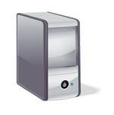

High Level View – Ordering Portal and API Example
Google
DMZ
Portal Application
Mail Gateway
Orders
Products
Tickets
CRM
Billing
Customer
Complaints
Nginx
Framework and Common Components
Portal Web Server Proxy
DAM
Adobe CQ5 Platform
REST
Webgate
OAM
SOAP/MQ
SOAP/HTTP
JSON /Http
Portal DB
Elastic
Search
B2B
Logs
Internal User
Portal Admin
B2B API Gateway
CAMEL ESB
Enterprise Services and Systems
Customer User
Identity
MS
Ticket System
Products
Warehouse / Inventory
Accounting
Shipping
Analytics
Call Centre
WAF
SPLUNK

Slide 70
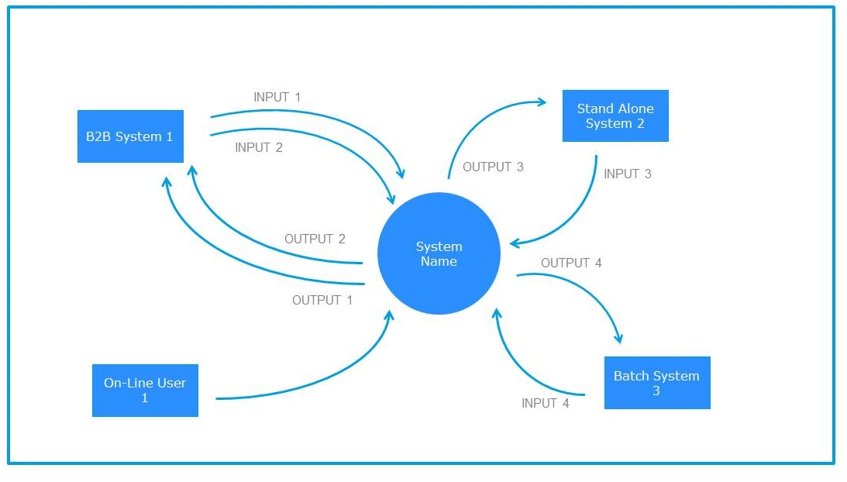
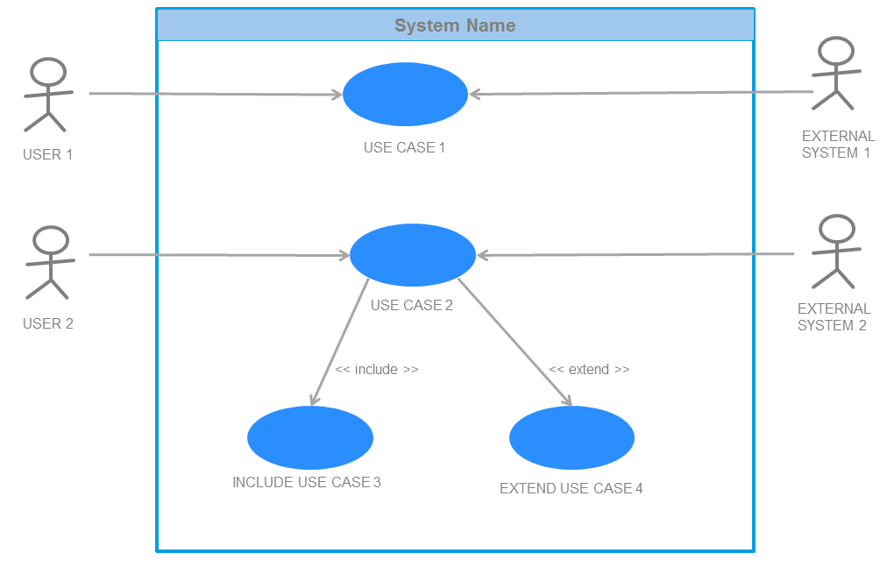
High Level Views – Context and Scope
A Use Case Diagram describes the scope from point of view of the various users of the system and how they achieve their goals.
Shows how actors use the system or how they are are impacted.
Provides some visibility into the system explaining the systems capabilities.
The Solution Context artefact helps define the scope of the system at an early stage in the project.
Used amongst the key stakeholders to set expectations, gain agreement on the scope and assist in delineating the project team and client responsibilities.
Can be developed Iteratively

Slide 71
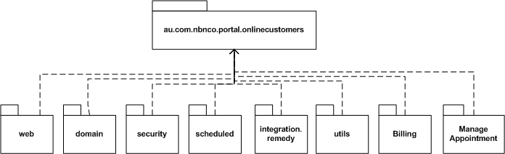
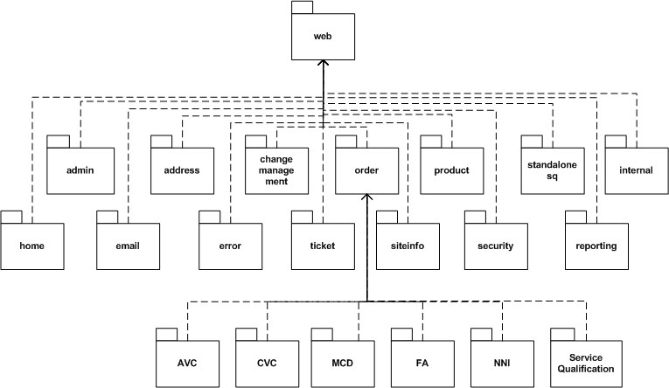
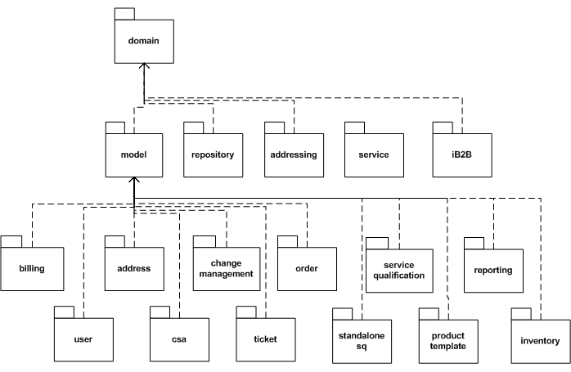
Application Structure View - Example
UML Package Diagram
A static view of the code

Slide 72
Application Configuration View – Runtime Deployment - Example
UML Deployment Diagram

Slide 73
Network Configuration + Tiers across Security zones
LEGEND
Access Tier
Perimeter WAF
Users
Presentation to Integration Tiers
Intermediary Zone
To DR Site
Global Site Sel
Resource Tier
443
Load Balancer
Perimeter security
Firewall
80
80
Trusted Application Zone
Proxy
Proxy
8083
8083
8083
Host VM / Firewall
Host VM / Firewall
Host VM / Firewall
ESB
Mail Gateway
Portal Jetty Server
Portal Jetty Server
Portal Jetty Server
9100
Host VM / Firewall
Host VM / Firewall
9100
Elastic Search
9400
9400
Elastic Search
Firewall
Trusted Data Zone
Portal DB
DR
Portal DB
Firewall

Slide 74
Tier Map View – Entity/Data Management at each Tier - Example
Data gets transformed and managed by different technology as it goes up the Tiers
Arch Decision | Presentation | Application | Domain/Integration | Resource
Data Structure | Value objects and JSP helper beans | XML/JSON | JEE Entity beans with POJO by-value dependents | SQL primitive types and Oracle BLOBs for images
Collection Handling | Lists of value objects | List of XML/JSON Array | List of Entity Bean keys | Relational tables
Query API | JEE and JQuery calls | XPATH (XML Only) | JEE calls | Relational tables and views for reads, stored procedures for updates
Navigational API | No local navigation | XML as above | Embedded by-value dependent objects, otherwise through canned services | SQL
Integrity Management | Local format validation for structured fields, drop-down lists from back-end data sources | XSD (XML Only) | Full integrity checking with some redundancy with resource and client tiers; exception errors with explanation strings | Foreign key and some triggers in database
Transaction Control | None | XML - WS Atomic Transactions JSON None | For each method invocations using EJB mechanisms | Transaction boundaries managed externally, SQL isolation level of repeatable reads

Slide 75
Qualities View – Describe the Solution Tactics - Example
How are the ‘relevant’ qualities achieved at each layer.
Layers | Component | Security | Throughput | Scalability | Reliability Availability | Manageability
Software | Order Web Page (Java, JSP) | UID & Password | Minimal session state, Lazy Finish | Separable Order System interface | Replicated Session, Loosely coupled functions | Common LDAP User records
Software Platform | Apache Tomcat | SSL, LDAP ACLs, Webgate Proxy | Resource pooling | App Server Clustering | Primary/ Secondary LDAP | Remote SNMP admin
Operating Platform | VMWare VM | Restricted user base, VM isolation | VM Memory On demand | VM Memory On demand, VM duplication | VM Restart (Test, pre-prod environments) | Remote SNMP admin, VMware vSphere vMotion
Compute & Network | Cisco UCS | Restricted user base, physical isolation, firewalls | Load balanced, dedicated server, multi-processor | Expandable width, expandable processor | Clustering, redundant network connections | Remote SNMP admin

Slide 76
Viewpoint Models / Artefacts
Layer | View | Typical Model/Artefact
High Level |  | A functional description of the application that all stakeholders can appreciate. A custom graphic, system context or UML use case diagram.
Application | Structure | Mainly UML package, Composite Structure diagrams. UML class, object, State machine when required.
 | Configuration | UML component or deployment diagrams. Component diagrams can be overlaid on deployment diagrams. Include Interfaces and Ports.
 | Behaviour | Patterns, Process diagrams, BPM models, Tier Map. UML Sequence, Activity, Communication and Interaction Diagrams.
 | Tier Map Data @ Layer | Tier Map (Across Layers) - Information Model (IA), Domain Object Model, Class/Object or ER Models.
 | Process | UML Object Diagram with Process Annotation, Sequence, Communication and Timing Diagrams.
Software Platform | Incorporated Mechanisms | UML Component/Interface Diagrams, Reference to APIs, Specs/Contracts.
 | Custom Mechanisms | UML diagrams as for the Application Layer. UML Interface Diagram Reference to APIs, Specs/Contracts
Shared Services | Configuration | UML Component Diagram, reference to Services, APIs, Specs/Contracts
Operating Platform | Configuration | UML deployment diagram showing nodes and dependencies
Compute & Network | Configuration | Compute and Storage : UML deployment diagram showing nodes and dependencies. Network: Diagram (Routers, Load Balancers, Firewalls etc..)
Systemic Qualities |  | Systemic Qualities Decisions / Tactics by Layer

Slide 77
Views by Stakeholders (subset)
Layer | View | Architect/ Reviewer | Cost Reviewer | Designer/ Builder | Project Mngr | Maintainer | Operator/ Installer
Application | Structure | P | S | P | P | P
 | Config | S | P | S | S | S | P
 | Behaviour | S |  | P |  | P
 | Process | P |  | S |  | P
Software Platform | Incorp Mechs | P | P | S | S | P
 | Custom Mechs | P | S | P | P | P
Shared Services | Config | S | P | S | S | S | P
Operating | Config | S | P | S | S | S | P
C&N | Config | S | P | S | S | S | P
Systemic Qualities |  | P |  | S |  | P
P = Primary Interest
S = Secondary Interest

Slide 78
Patterns View – Organised by the cube - Example
Web, Mobile, App
API Gateway
Backend Front End
MVC
Front Controller
MVP
PM
MVVM
Service Worker
Application Controller
MacroServices
MicroServices
Unit of Work
Remote Facade
Application
Client
Presentation
Domain
Access
Integration
Resource
Evolutionary
Software
Service
Entities
Aggregate
Specification
Value Object
Developmental
Repository
Data Mapper
Table Module (TM)
Transaction Script (TS)
Active Record (AR)
Query Object
Table Data Gateway
Row Data Gateway
DAO
Circuit Breaker
Client Load Balancer
Bulkhead
Software Platform
Manifest
Shared Services
Operational
Operating Platform
Compute and Network
Facilities
Separated Interface
DTO
Adapter
Command
Observer
Feature Toggle
Service Registry
Configuration Service
Monitoring Service
Authorisation
Horizontal Scaling
Immutable Servers

Slide 79
SAD* Structure – The Word Template - Part 1
1. Introduction
1.1. Background
1.2. Purpose
1.3. Scope
2. Goals and Requirements
2.1. Quality of Service Goals
2.2. Technical Requirements
2.3. Constraints and Dependencies
2.3.1. Development Process and Team
2.3.2. Environment and Technology
2.3.3. Delivery and Deployment
2.4. Assumptions
3. Risks and Architecturally Significant Requirements
3.1. Risks Addressed
3.2. Architecturally Significant Requirements
4. High Level Solution Overview
5. Software Application Layer
5.1. Structure View
5.1.1. Client Tier
5.1.2. Access Tier
5.1.3. Presentation Tier
5.1.4. Services Tier
5.1.5. Domain Tier
5.1.6. Integration Tier
5.1.7. Resource Tier
5.2. Configurations View
5.3. Behaviour View
5.4. Process View
5.5. Security and Identity
5.5.1. Identity Management
5.5.2. Access Management
5.5.3. Encryption / Tokens / Certificates
5.6. Data Across Tiers
5.7. Evolutionary Considerations
Evolutionary Considerations – where are we heading strategically, next release, architectural runway.
*SAD = System Architecture Document

Slide 80
SAD Structure – Part 2
6. Software Platform Layer
6.1. Client Tier
6.2. Presentation Tier
6.3. Integration tier
6.4. Resources Tier
6.5 Software Infrastructure
7.1. Incorporated Mechanisms
7.2. Custom Mechanisms
7.3. Evolutionary Considerations
8. Enterprise Services and Infrastructure
8.1. Services Configuration View
8.2. Infrastructure Configuration View
8.3. Evolutionary Considerations
9. Operating Platform Layer
9.1. Configurations View
9.2. Evolutionary Considerations
10. Compute and Network Layer
10.1. Configurations View
10.2. Evolutionary Considerations
11. Facilities
11. Qualities of Service Review
11.1. Availability
11.2. Scalability
11.3. Performance
11.5. Agility, Extensibility and Flexibility
11.6. Security, etc
For each Quality / Concern
Item | Description
Requirement
Architectural Solution
Validation Strategy
Evolutionary Considerations

Slide 81
Solution Arch Document (Common Mini EA Based Style)
1. Introduction
2 Capability Definition
2.1 Business Rationale
2.2 Business Drivers
2.3 Scope
2.3.1 Objectives
2.4 Core Functional Requirements
3 Business Context Overview
4 Solution Overview
4.1 Key Non-Functional Requirements
5 Solution Phase Overview
5.1 Current Solution
5.2 Proposed Solution
5.3 Identified Future Capabilities
6 High Level Process Overview
6.2 AS-IS Process Impacts
7 Application Architecture
7.1 Platform and Capabilities
7.2 Application Context
7.3 Capabilities Definitions
7.5 Non Functional Considerations
8 Data Architecture
9 Integration Architecture
10 Technical Architecture
11 Data Conversions and Migrations
13 Risks, Issue, Assumptions and Dependencies
14 Architectural Decisions
A mini
EA, a segment capability.

Slide 82
Solution Arch Document (4+1 Based Style)
1 Introduction
2 Scope
3. Software Architecture
4. Architectural Goals & Constraints
5. Logical Architecture
6. Process Architecture
7. Development Architecture
8. Physical Architecture
9. Scenarios
10. Size and Performance
11. Quality
Appendices
A. Acronyms and Abbreviations
B. Definitions
C. Design Principles
Logical / Design View
Implementation / Development View
Use Case View
Process View
Physical / Deployment View

Slide 83
The Approach

Slide 84
Cube Architecture Approach in RUP Lifecycle (Phases)
Phase
Inception
Elaboration
Outline Context
Define Solution
Refine Solution
Planning
Analyse
Analyse
Context
Complexity Analysis
Gap Analysis
Apply
Determine Style
Choose Platforms
Strategy Selection
No
Risk Managed
Restructure
Yes
Define Context
Solution Outline
Refine and Restructure
Work Packages
Use Cube
Use Decomposition

Slide 85
Cube Architecture Steps
Choose Platforms Step:
While Risks/Gaps do {
Select
Instantiate
Determine Arch Significant Items
Analyse Gaps
Analyse Risks
}
For each Tier {
Determine the Software and Hardware Stack
Document Incrementally using Cube Template
}
Application
Client
Presentation
Domain
Access
Integration
Resource
Evolutionary
Software
Developmental
Software Platform
Manifest
Shared Services
Operational
Operating Platform
Compute and Network
Facilities

Slide 86
12 Decomposition Heuristics fit in Subsumption Groups
Always consider applying all 12 heuristics
Group | Order | Heuristic
One | 1 | Bounded Context/Teams
Two | 2 | Layering/Service Tiering
 | 3 | Distribution
 | 4 | Exposure
 | 5 | Functionality
 | 6 | Generality
 | 7 | Aspectual
Three | 8 | Coupling & Cohesion
 | 9 | Volatility
Four | 10 | Configuration
Five | 11 | Planning & Tracking
 | 12 | Work Assignment
2 Dimensions of Cube
Heuristic (subsumption) group
Obey group ordering (1-5)
Order is not important within a group

Slide 87
Decomposition Heuristics
Heuristic | Description
Bounded Context/Teams | Partition the domain into areas with a common ubiquitous language. Understand relationship types. Structure teams within contexts to be independent and autonomous.
Layering/Service Tiering | Ordering of concerns; cohesive services within a layer, expose via interface – low coupling.
Distribution | Partitioning by distribution among computational resources, provides scalability;
Exposure | Decide what to expose to other components, via interfaces. Separate implementation.
Functionality | Decompose into Functional units ,e.g. service groupings within the problem space.
Generality | How general or specific to make something to make it reusable across projects or products.
Aspectual | Cross-cutting concerns, implemented as aspects, e.g. logging, security.
Coupling & Cohesion | Partition by Reducing Coupling and Increasing Cohesion.
Volatility | Isolate things that are more, verses less likely to change, or things that simply change on different schedules.
Configuration | Systems must support different configurations (for environments, pricing, usability, performance, security, etc.)
Planning & Tracking | Break a big thing apart so that work can be defined in smaller time units against the smaller parts.
Work Assignment | Partition by physically-distributed teams, matching skill-sets, security areas (clearance), and contractual concerns.

Slide 88
Micro ‘Service’
A microservice architecture is:
“a service-oriented architecture composed of loosely coupled elements that have bounded contexts.”
Adrian Cockcroft (Director of Web Engineering Netflix)
"The microservice architectural style is an approach to developing a single application as a suite of small services, each running in its own process and communicating with lightweight mechanisms, often an HTTP resource API. These services are built around business capabilities and independently deployable by fully automated deployment machinery.”
Martin Fowler in March 2014

Slide 89
Microservice Method
Start by analysing the business domain to understand the application's functional requirements. The output of this step is an informal description of the domain, which can be refined into a more formal set of domain models.
Ensure the NFRs, and constraints are also understood. Each microservice may have different NFRs.
Next, define the bounded contexts of the domain. Each bounded context contains a domain model that represents a particular subdomain of the larger application.
Within a bounded context, apply tactical DDD patterns to define entities, aggregates, and domain services.
Use the results from the previous step to identify the microservices in your application.

Slide 90
MicroServices - Separated by Concern (Bounded Context)
The business can be broken into ‘Small’ Fine Grained services that exists within within bounded contexts.
Theses contexts have a separation of concerns and capability, that are independently and continuously deployed, managed, monitored.
Applications may be made up of 100’s of MicroServices;
May need to provide encompassing aggregates of these for consumers to consume more easily;
Need to provide a way for consumers to find and use services.
External Provider
App
Aggregate Service
Aggregate Service
App
Billing
Ordering
Aggregate Service
Customer
Service
App
Aggregate Service
Inventory
External Consumer

Slide 91
Distribution (Tier-ing)
Decomposition according to some ordering principle, typically partitioning and distribution among computational resources (containers/VMs/boxes).
Primary technique for building scalable systems.
Separation of concerns to separate layers and then deploy each separately to separate tiers.
Example: 3 Tier System
Client
Tier
Business / Domain
Tier
Resource
Tier
Notes:
Since the goals and structure of processes/threads is often orthogonal to other aspects of a system, it typically cuts across many subsystems and is therefore often difficult to manage if it is buried deep in a system’s structure.

Slide 92
Exposure - Break Monolith into Layers
Decide what to expose to other components, via an API
Any given component fundamentally has three different aspects (layers)
Component
Services
(API-Interface, abstraction)
Domain
(Implementation, action)
Integration (adaptation)
This is further discussed in SOA Module.
Notes:
Services (interface, abstraction), or what the unit offers
Logic/implementation (action), or what the unit does internally
Integration (adaptation), or how the unit accesses other units. Wrappers or adaptors components fit into this category, insofar as they make an external paradigm fit into one’s own.

Slide 93
Micro Service Layers – Exposing a Component
Applying the layered architecture pattern to components, e.g. a Microservice component
Protocol Abstraction – Client channel
Logical Abstraction – expose for particular use cases
Services
(Interface, abstraction)
Application Logic Implementation, Workflow/Orchestration.
Manage Data
Domain
(Implementation, action)
Integration (adaptation)
Logical Adaption - of tiers below for what we need (transform and protect via anti corruption layer)
Protocol Adaption – connect and to talk to tier below
Notes:
May break Service Interface further into the API and Maintenance Interfaces

Slide 94
Exposure – Add Operations Interfaces
For complex units these may be broken apart into several pieces, and Interfaces for both:
API (Data and Business Functions)
Maintenance (Operations), Management of the Component
Services (Interface, abstraction)
API
Maintenance
Domain
(Implementation, action)
Integration (adaptation)
Notes:
May break Service Interface further into the API and Maintenance Interfaces

Slide 95
Exposing Tiers - Layers
Tier N
Interface, abstraction
Implementation, action
Integration, adaptation
Tier N+1
Interface, abstraction
Implementation, action
Integration, adaptation
Tier N+2
Interface, abstraction
Implementation, action
Integration, adaptation

Slide 96
The Value of the Cube – a tool for analysing your architecture
Make Architecture Orthogonality Explicit by Clarifying:
Tiers: Conceptual, Logical and Physical:
Services;
Decomposition Decisions;
Deployment Decisions.
Layers: of Software/Hardware, Platforms and Infrastructure;
Qualities Of Service (QOS)
Cross Cutting concerns that drive continuous architecture.
Provide Views and Viewpoints:
Provide a clear set, relevant to stakeholders;
Organised in context, within layers, across tiers and QOS.
A Framework that is both:
Descriptive – use to analyse, review, evaluate and explain existing systems;
Prescriptive – model new systems.
Basis for an architectural process and decision making.
Covers:
Modern Styles: N-Tier, SOA, Micro-Services and Cloud(PaaS, Iaas, SaaS)
Benefits: Agility, Continuous Delivery, Reuse
Both Platform and Architecture

Slide 97

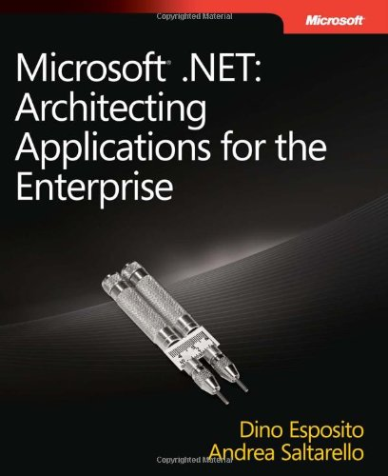
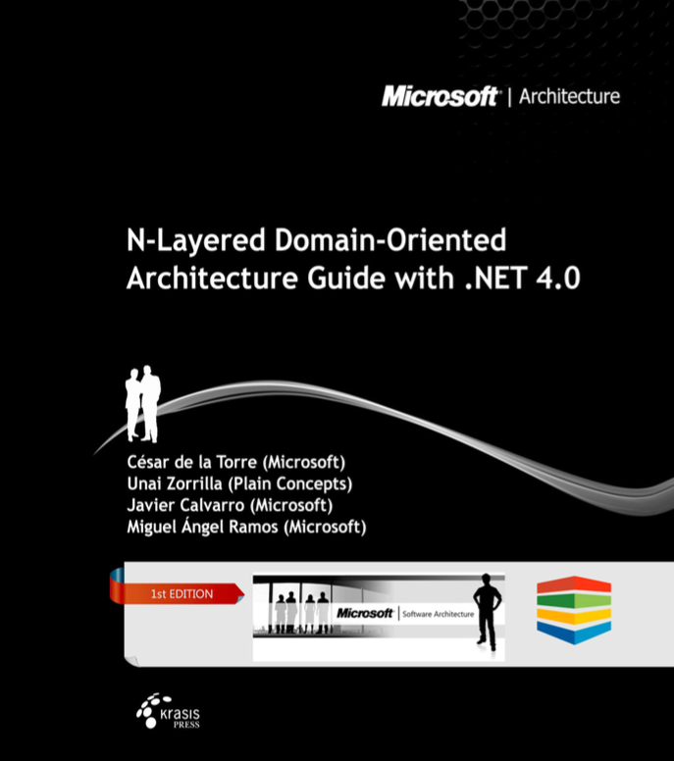
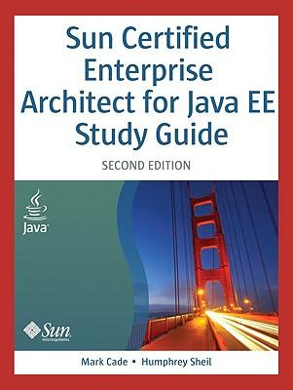

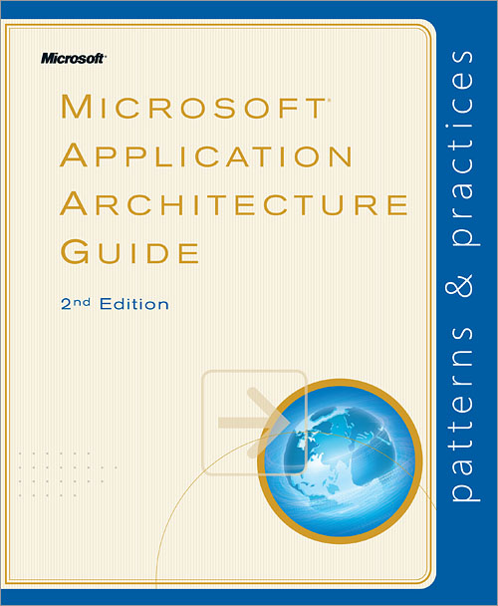
References:
Cube was basis of:
Sun’s ‘Dot-Com & Beyond’ - Architecture Methodology Published: June 11, 2001;
Sun Certified Enterprise Architect for Java EE Study Guide, 2010;
J2EE Core Patterns;
Extended to cover .Net platforms

Slide 98
The End

Slide 99
Pattern Notes
Transaction Script: A business component that captures procedural user actions and business logic, e.g. order product, book a flight, in a procedure/method.
Command Object: Encapsulate request processing in a separate object with a common execution interface. Used to represent the script, the action.
Table Module: A business component that handles the business logic for a whole DB table, e.g. customer_table, order_table. Although an object is used, it represents a DB table, not a domain object.
Active Record: An object that wraps a record in a DB table or view, represents a row of data. Object holds table/entity attributes, with CRUD methods.
Data Mapper. A mapping layer between objects and the database structure that is used to move data from one structure to another while keeping them independent.
Data Transfer Object. An object that stores the data transported between processes, reducing the number of method calls required.
Query Object. An object that represents a database query.
Repository. An in-memory representation of a data source that works with domain entities.
Row Data Gateway. An object that acts as a gateway to a single record in a data source.
Table Data Gateway. An object that acts as a gateway to a table or view in a data source and centralizes all of the select, insert, update, and delete queries.
Record Set: in memory representation of a DB table;

